Slide 1
Making sense of neural population data
Chen DataSAI
Ann Kennedy
7/7/2022

Slide 2
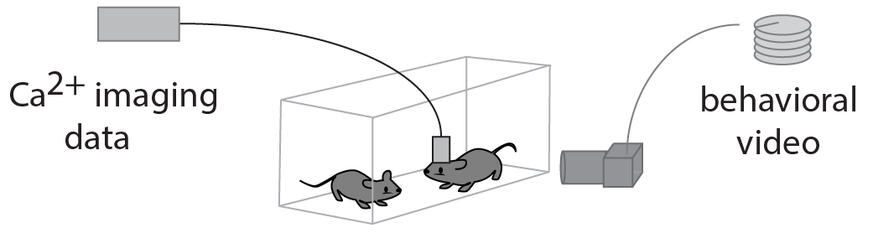
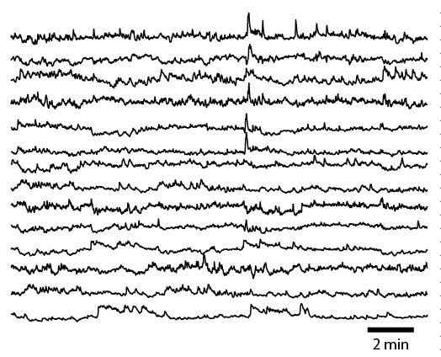
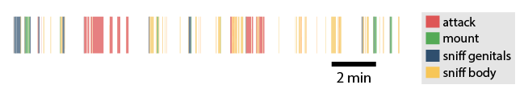
So you’ve collected some data
Extracted calcium signals
Behavior annotations
???
50 - 300
neurons

Slide 3
4 approaches to making sense of population data:
Tuning analysis (“what do the responses of individual neurons look like?”)
Decoding (“what information about the world is present in the neural activity?”)
Population distance (“how clear is the information that’s being encoded?”)
Dimensionality reduction (“what is the overall structure of the neural activity?”)

Slide 4
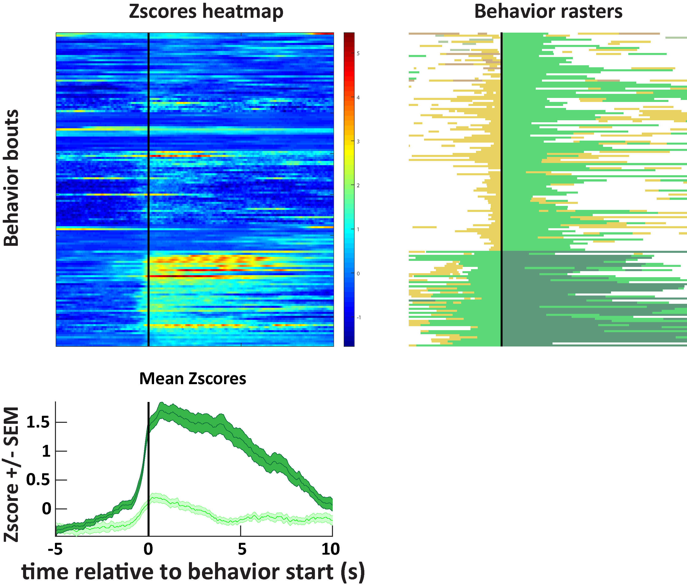
1. Analyzing neural “tuning” (what cells respond to)
Behavior aligned on event
Activity of one neuron aligned on event
mount
trial 1
High ΔF/F
sniff
follow
trial 47
Low ΔF/F
Event-triggered average

Slide 5
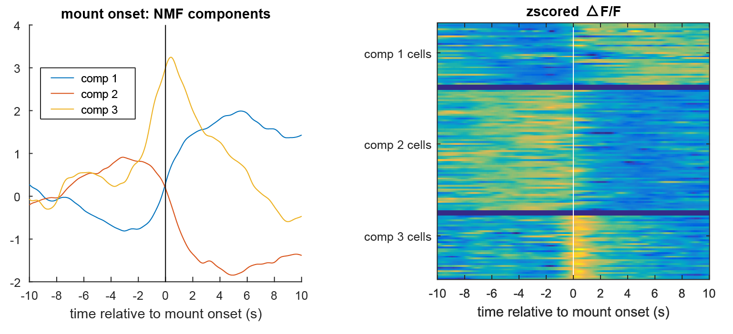
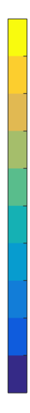
1. Analyzing neural “tuning” (what cells respond to)
ΔF/F of 135 clustered neurons
high
cluster 1
cluster 1
cluster 2
cluster 3
cluster 2
cluster 3
low

Slide 6
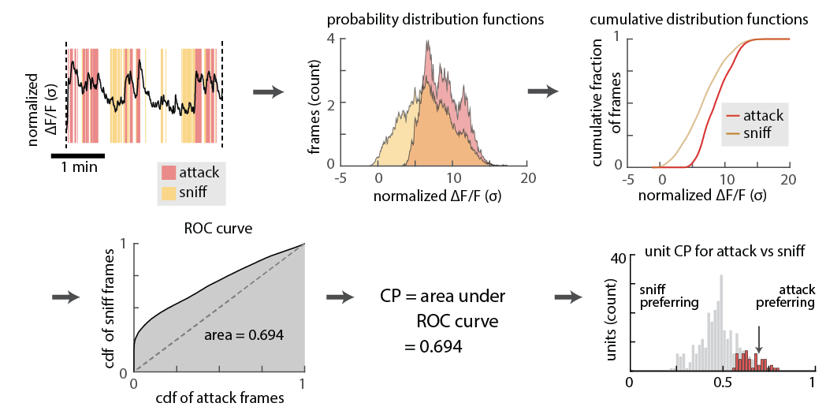
Finding behavior-tuned units via their auROC (aka Choice Probability)

Slide 7
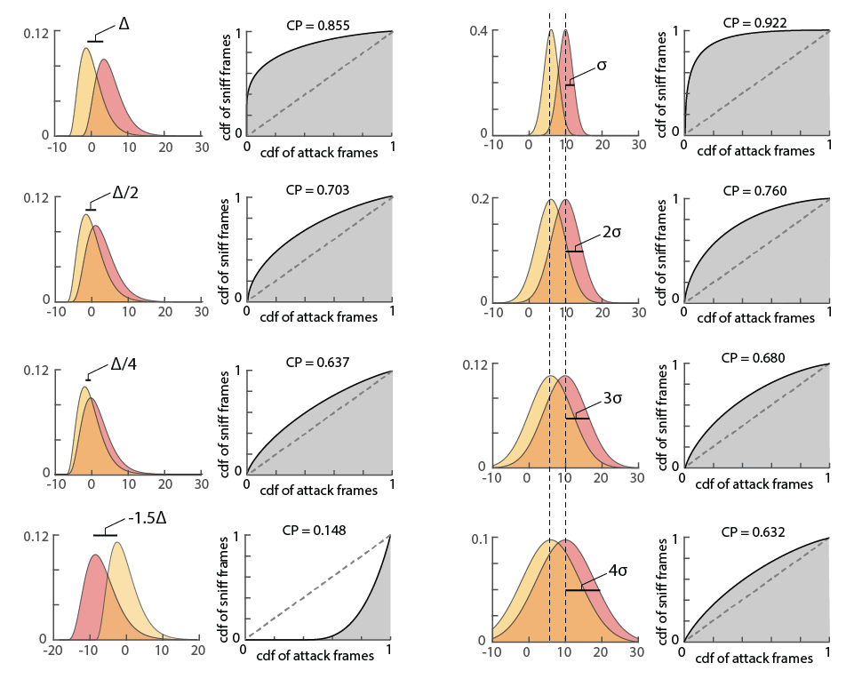
Finding behavior-tuned units via their auROC (aka Choice Probability)

Slide 8
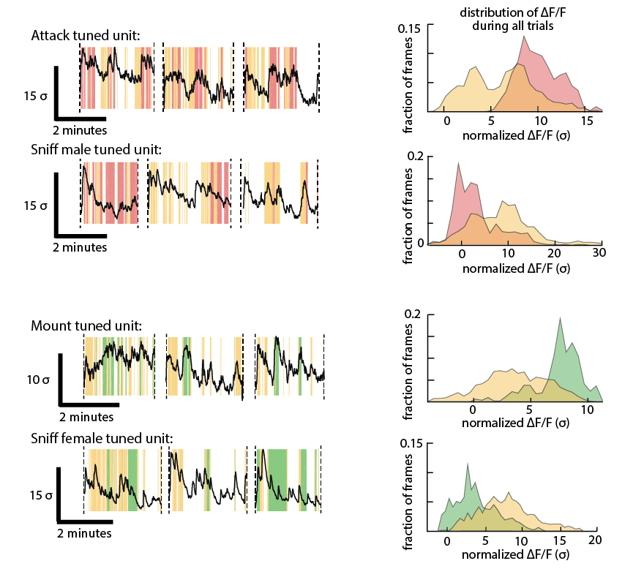
Finding behavior-tuned units via their auROC (aka Choice Probability)
Distribution of cell activity across all trials

Slide 9
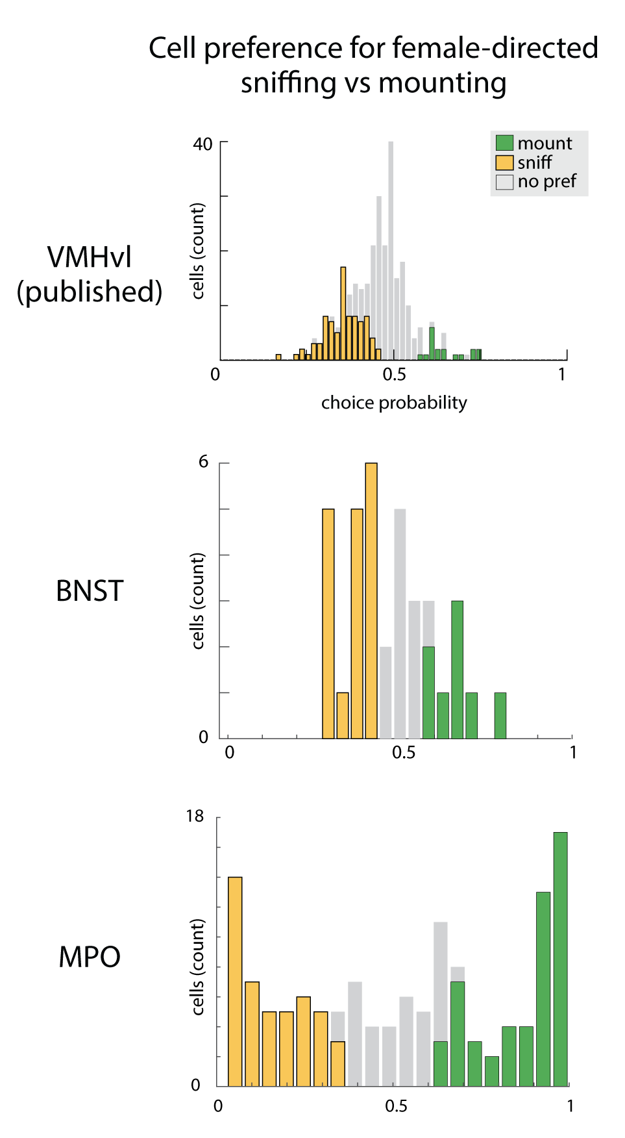
Finding behavior-tuned units via their auROC (aka Choice Probability)
VMHvl
BNST
MPOA
no
preference
mount-
responsive
sniff-
responsive
no
preference
mount-
responsive
sniff-
responsive
no
preference
mount-
responsive
sniff-
responsive

Slide 10
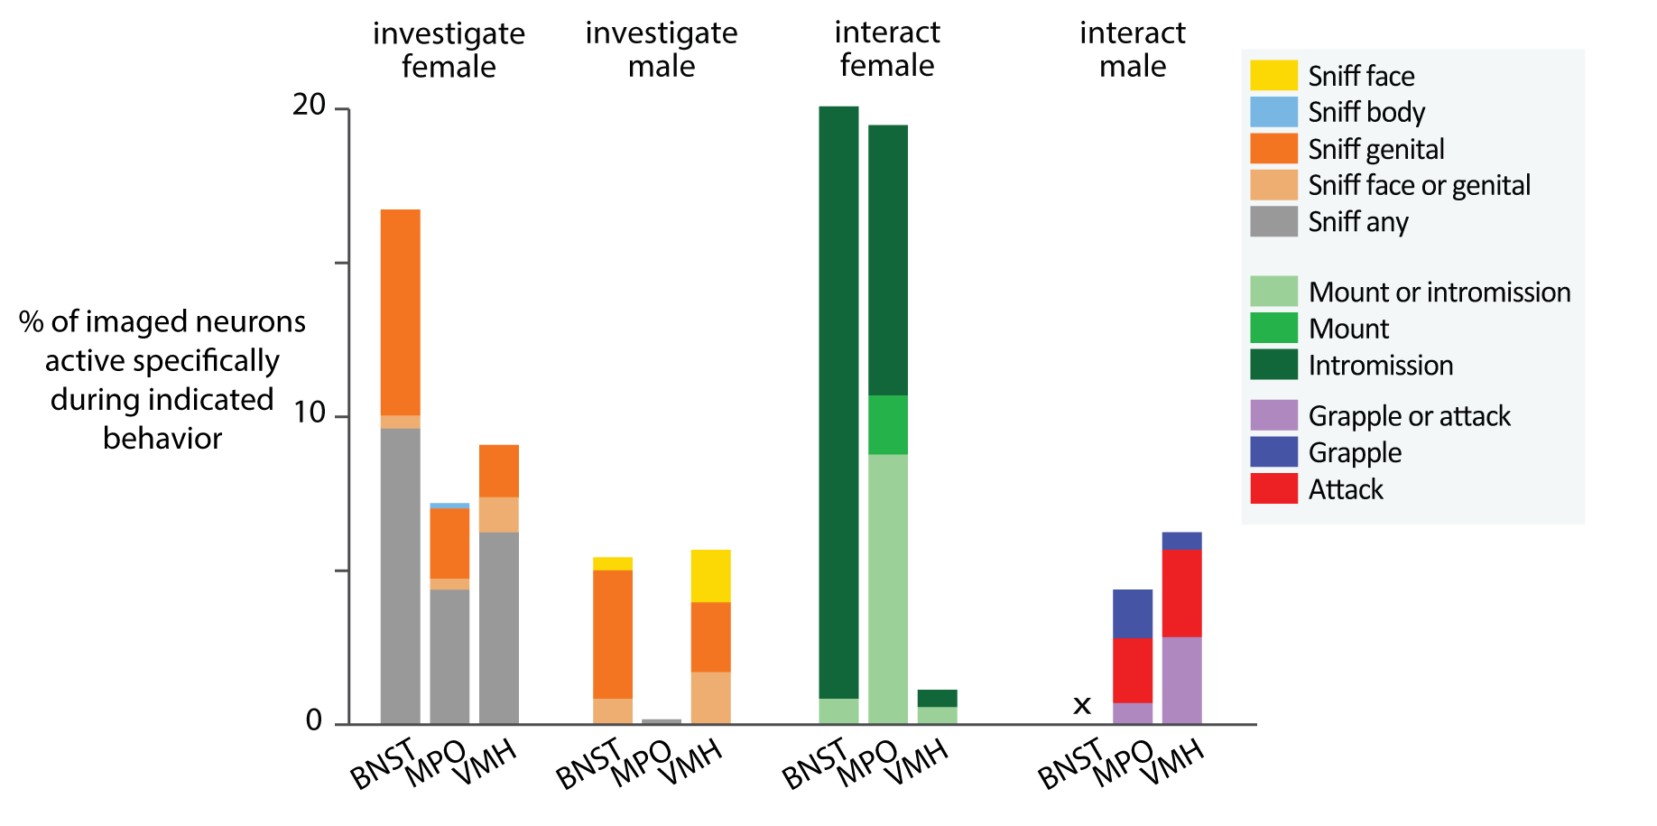
Contrasting representations of behavior across brain regions

Slide 11
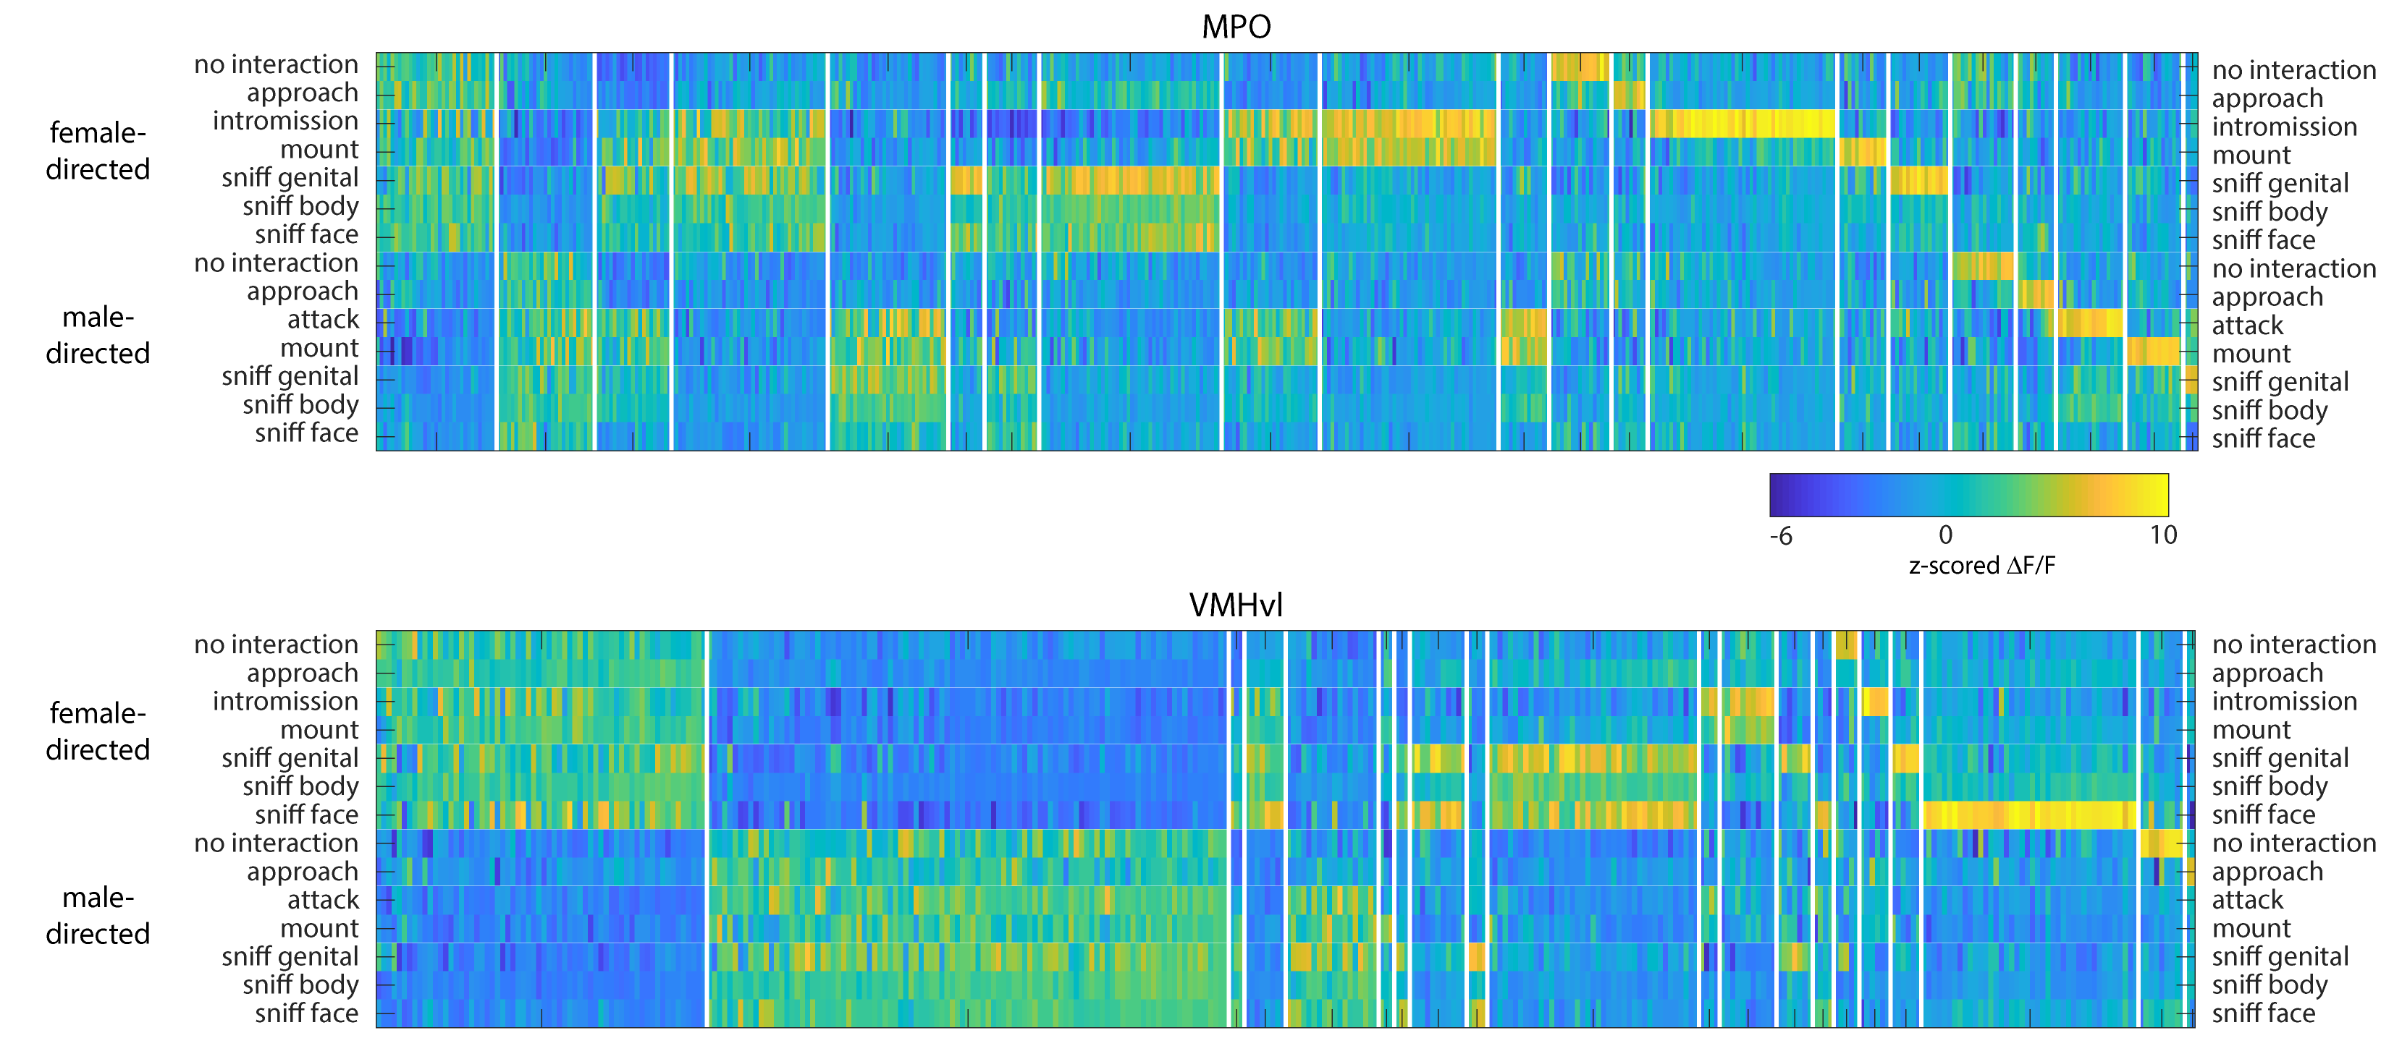
Using single-neuron tuning properties to contrast two brain areas
intruder sex
behavior
Nair et al, in press
Karigo et al, 2021

Slide 12
Using single-neuron tuning properties to contrast two brain areas
intruder sex
behavior
intruder sex
behavior
Nair et al, in press
Karigo et al, 2021

Slide 13
2. Using decoders/classifiers to determine what information can be read out from a neural population
Stimulus feature
Recorded spikes
decoding
encoding
time ->
time ->

Slide 14
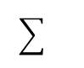
2. Using decoders/classifiers to determine what information can be read out from a neural population
Why a linear classifier?
w
Train linear classifier
to predict behavior from
imaged activity of neurons
SVM
Naïve Bayes
Perceptron
Fisher’s linear discriminant
threshold
Linear classifiers are a lot like neurons, in principle.
r_{i} (t) = w₁ x₁(t) + w₂ x₂(t) + … + w_{n} x_{n}(t)

Slide 15
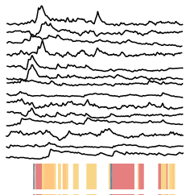
2. Using decoders/classifiers to determine what information can be read out from a neural population
Training vs Testing
Be sure to make sure your test set is truly independent of your training set!
w
threshold

Slide 16
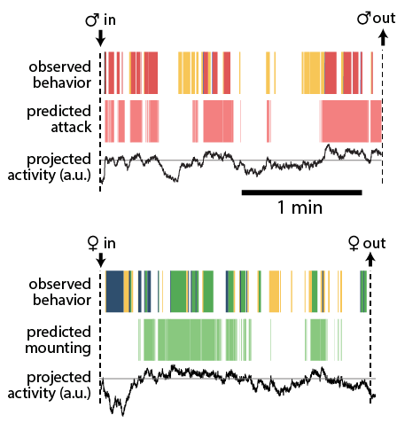
We can try to decode current behavior from the activity of neurons:

Slide 17
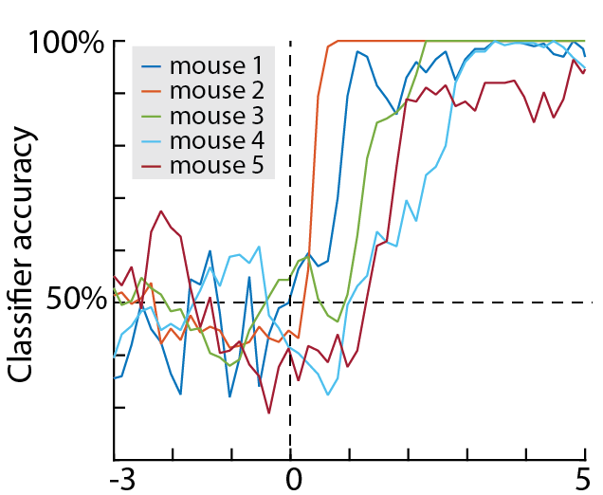
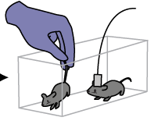
We can use decoding to ask when information appears in the system:
Accuracy in
predicting
sex of
intruder
mouse
How long does the animal take to determine
the sex of the intruder mouse?
Time relative to contact (sec)

Slide 18
We can investigate the appearance and disappearance of predictable states in the network:
Predict future behavior from current neural activity (“preparatory activity”)
Predict past inputs from current neural activity (“memory trace”)
dt
dt

Slide 19
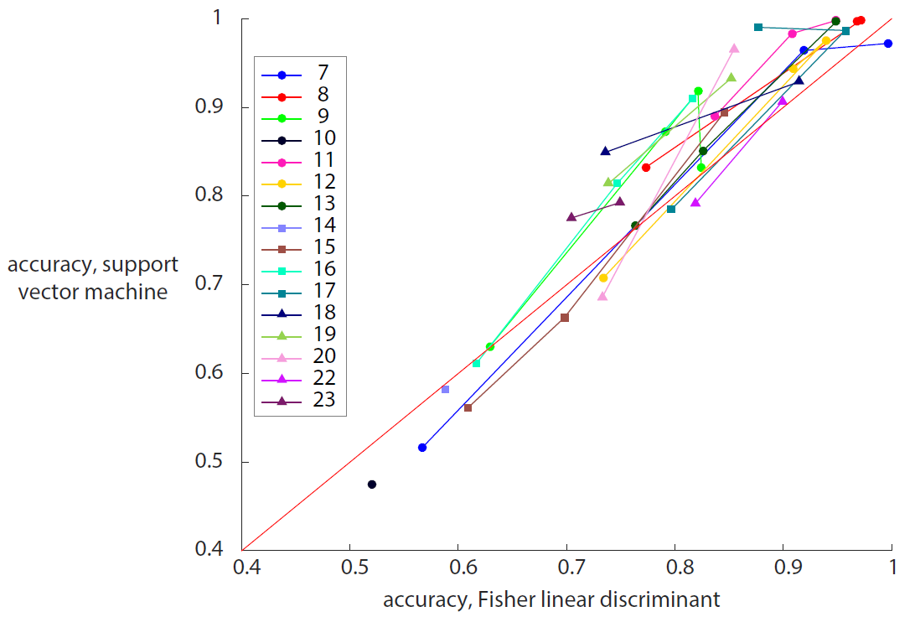
Does choice of decoder matter?
Among linear decoders,
hopefully not too much?

Slide 20
Some things to keep in mind
Shuffle your data to make a “control” decoder
Use F1 score instead of accuracy when your classes aren’t balanced
Separate your training and test set cleanly! Don’t just randomly assign frames
Use dimensionality reduction when you don’t have a lot of training data
A decoder trained on one mouse can’t be run on another

Slide 21
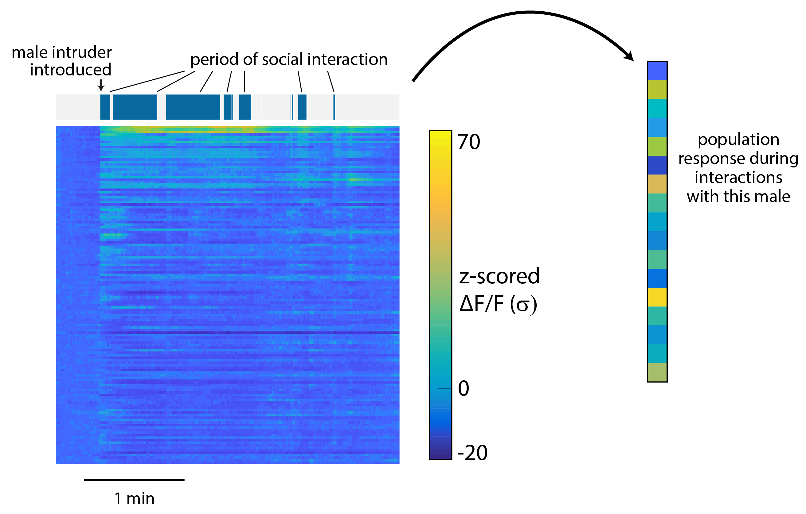
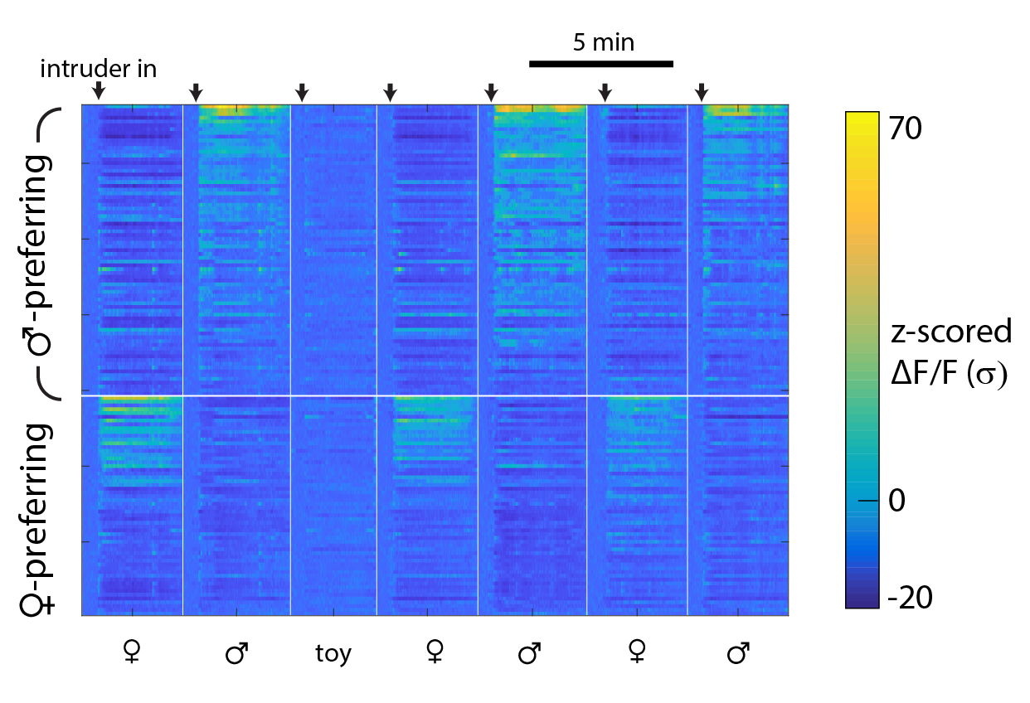
Measures of distance or similarity tell us how much two neural states resemble each other
N neurons
Response
to male
intruder
Response
to female
intruder
Averaged across all periods of social interaction
Or only periods of sniffing
Or when the intruder is first introduced
Or while animals aren’t interacting

Slide 22
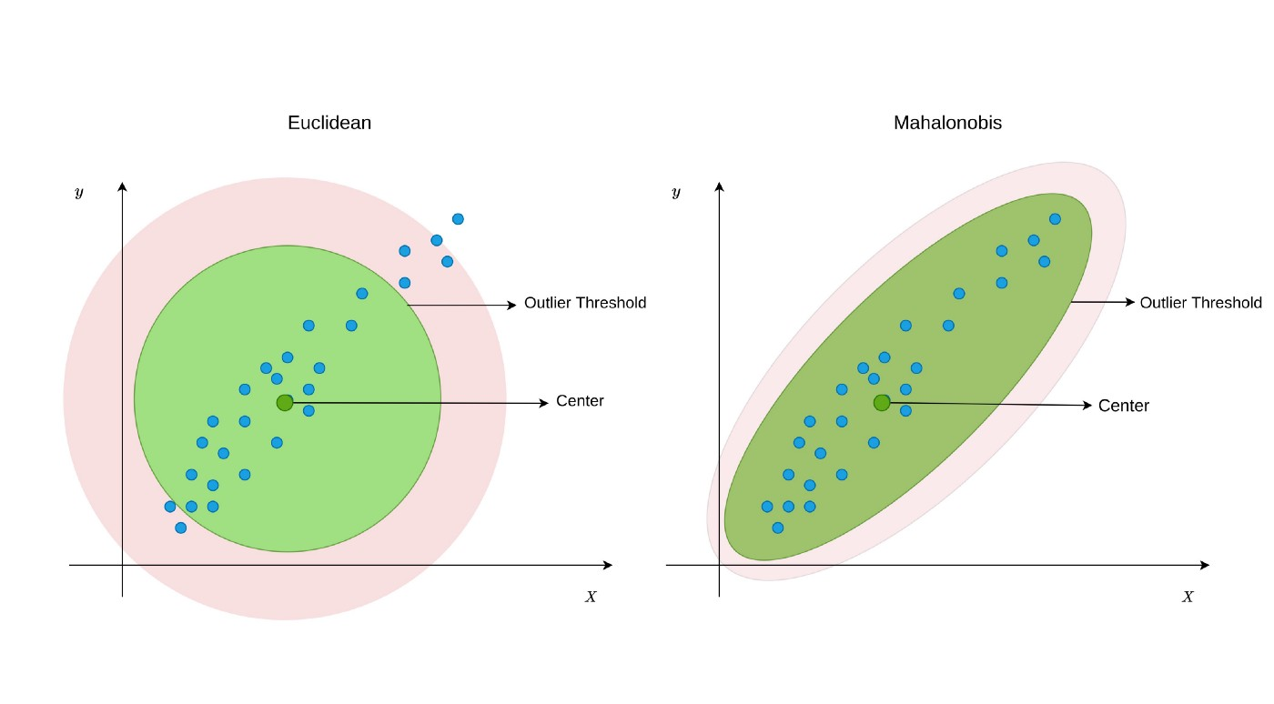

How do we measure “distance”?
Euclidean distance
Mahalanobis distance
Equidistant points
Equidistant points
center
center

Slide 23
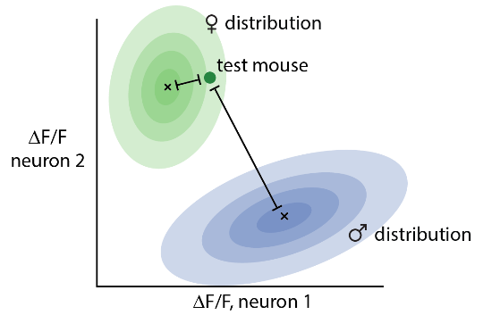
How do we measure “distance”?
Hold out one mouse for testing
Find distribution of data from remaining ♂/♀ mice in neural activity space
Compute distance of held-out mouse from both distributions, in units of standard deviations in each dimension.
Take the difference between (the log of) these distances.

Slide 24
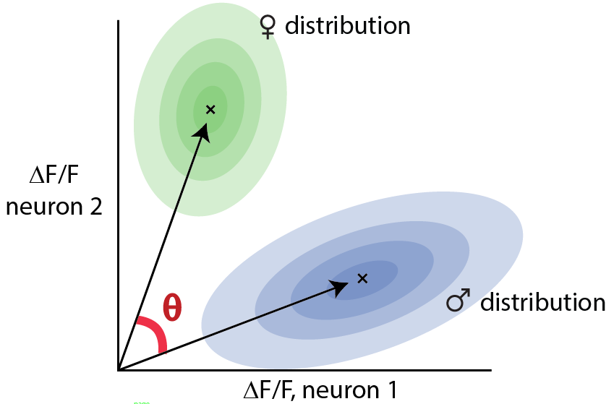
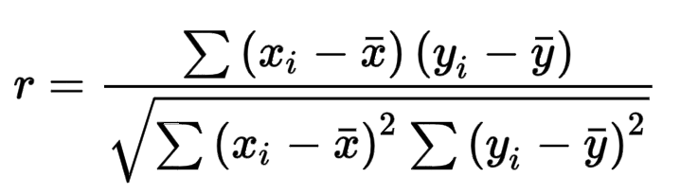
Distance vs similarity
Mahalanobis distance
Pearson’s correlation

Slide 25
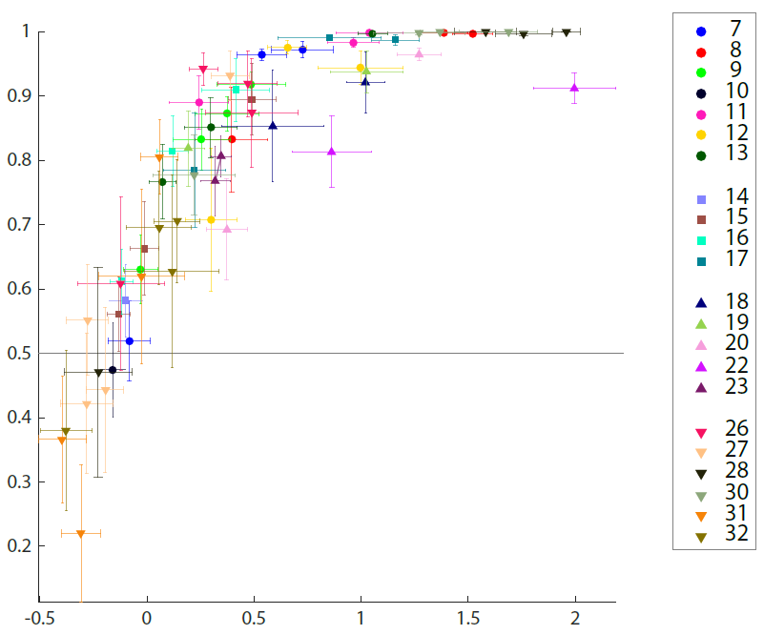
Measuring distance can overcome floor/ceiling effects encountered by decoders
Performance of an SVM decoder for intruder sex
Each point is one day from one imaged mouse
Error bars are +/- SEM
Mahalanobis distance between sex representations

Slide 26
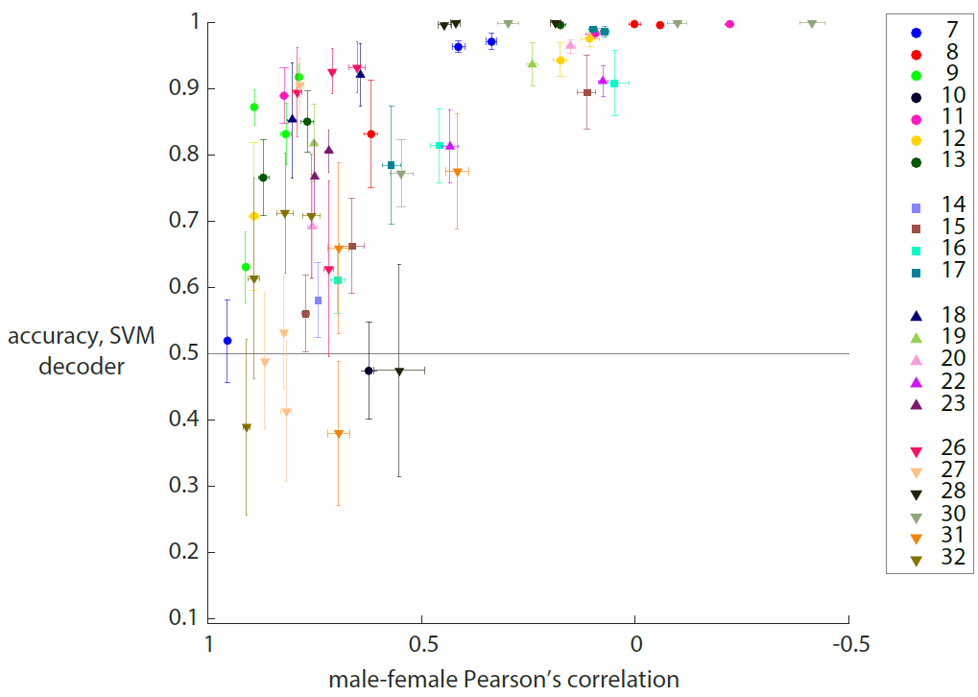
Some measures of distance (here, Pearson’s correlation) agree less with decoder performance
Each point is one day from one imaged mouse
Error bars are +/- SEM

Slide 27
Matlab demo time

Slide 28
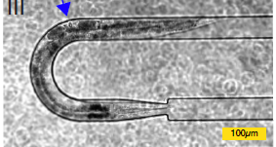
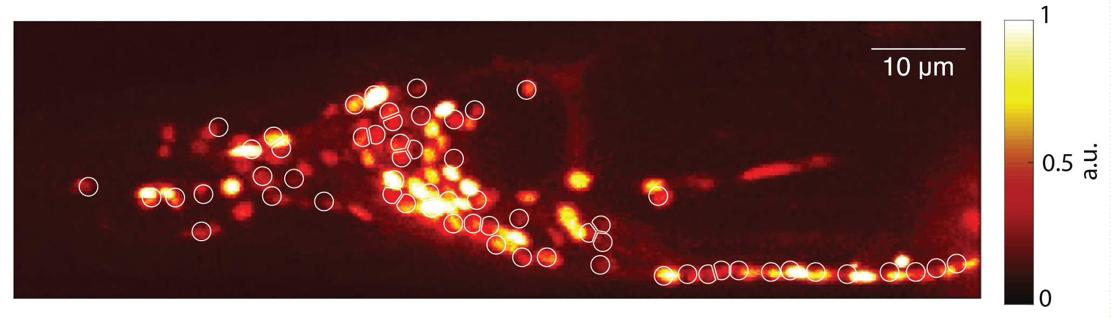
Sometimes PCA is useful: Kato et al (2015) Global brain dynamics embed the motor command sequence of C elegans
Signal from pan-neuronal, nuclear-localized GCaMP5K in head ganglia, with example ROIs.
C elegans immobilized in microfluidic device.
Image (most) neurons simultaneously in an immobilized worm, and visualize dynamics with PCA.
Kato et al 2015

Slide 29
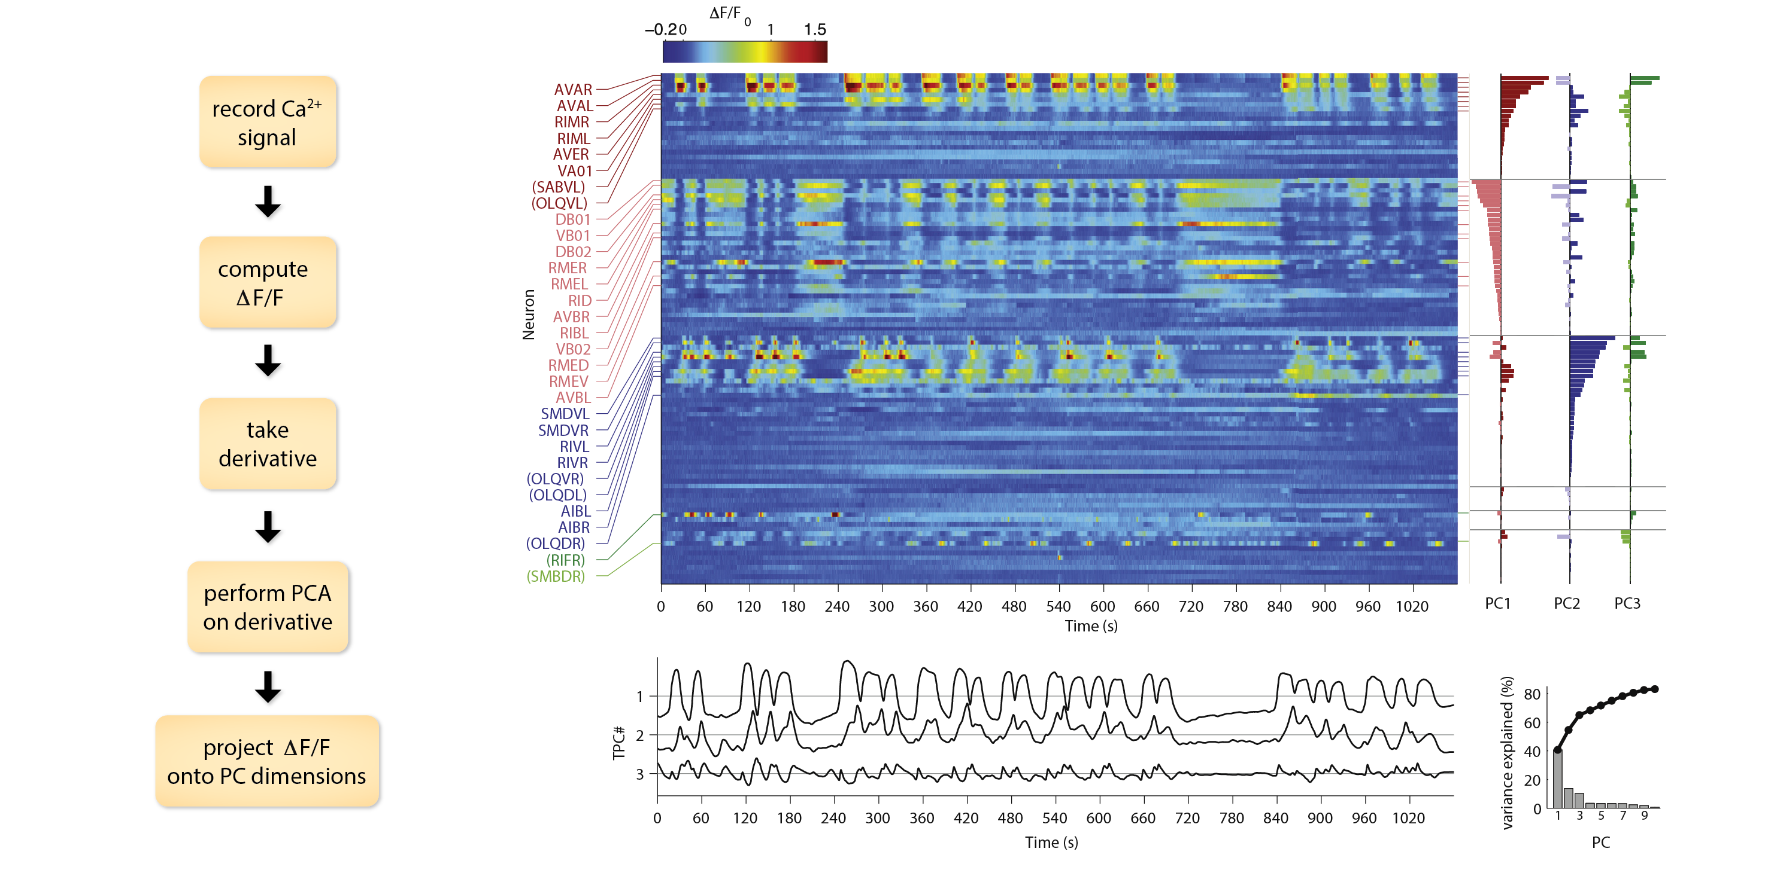
variance
explained
Kato et al 2015

Slide 30
Using PCA loadings to find similarly tuned neurons
Assign each neuron to a cluster based on which PC loading was highest (and whether it was positive or negative)
Sort neurons within a cluster based on their preferred PC loading
Kato et al 2015

Slide 31
Using PCA loadings to find similarly tuned neurons
Assign each neuron to a cluster based on which PC loading was highest (and whether it was positive or negative)
Sort neurons within a cluster based on their preferred PC loading
Kato et al 2015

Slide 32
Temporal
dynamics
of first 3 PCs:
Kato et al 2015

Slide 33
Important consideration: PCA allows positive and negative weights on neurons
Neurons that most strongly contribute to PC 1
neuron 1 – neuron 2
Neuron 1
Neuron 2
Kato et al 2015

Slide 34
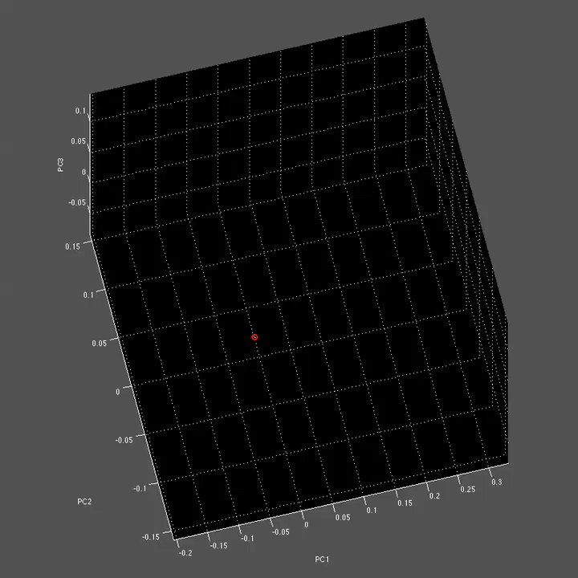
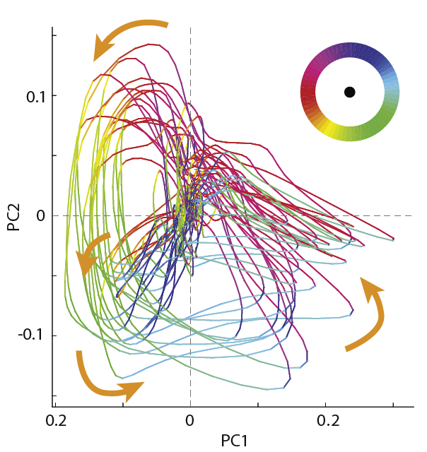
Direction of movement
in state space
Kato et al 2015

Slide 35
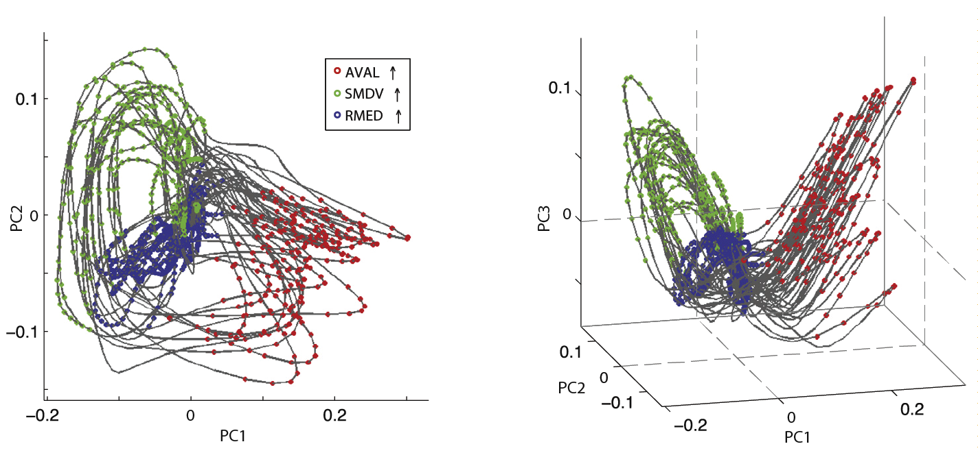
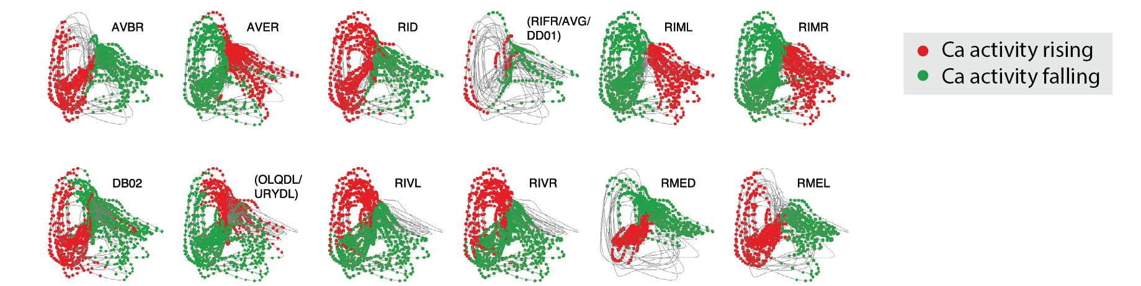
Activation of each individual neuron
occurs only when the population state
is in a particular portion of the manifold.
more examples:
Kato et al 2015

Slide 36
In addition to decoders, there are a few semi-supervised or constrained methods for dimensionality reduction:
“Find me the largest source of variance that is correlated with variable X”:
Partial least squares regression
Difference of covariances
demixed PCA
“Find me the largest source of variance that has the specified dynamics (eg smoothness, rotations)”
Gaussian process factor analysis (GPFA)
jPCA

Slide 37
Wrapping up
Tuning analysis (“what do the responses of individual neurons look like?”)
Decoding (“what information about the world is present in the neural activity?”)
Population distance (“how clear is the information that’s being encoded?”)
Dimensionality reduction (“what are the biggest signals in my data?”)

